Slide 1
Deep Residual Learning for Image Recognition
Kaiming He, Xiangyu Zhang, Shaoqing Ren, Jian Sun
Microsoft Research

Slide 2
Outline
Convolutional Neural Network
Idea of Residual Learning
Image Classification(CIFAR-10)
Image Classification(ImageNet)

Slide 3
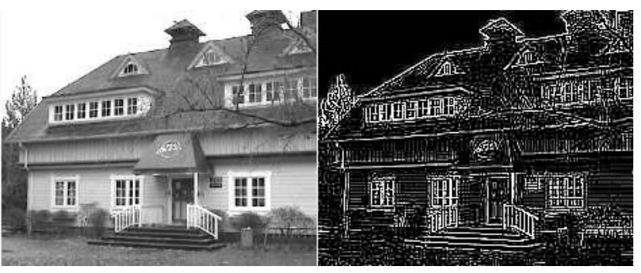
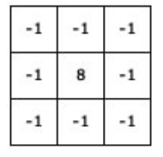
Edge Detection
source: http://aishack.in/tutorials/image-convolution-examples/

Slide 4
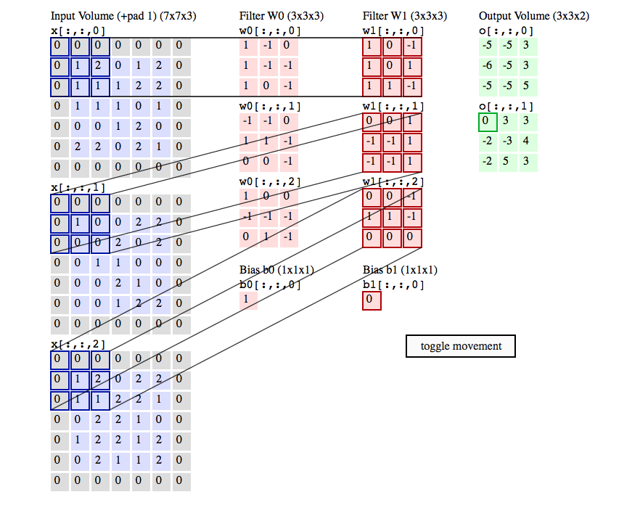
One Conv Layer
source:CS231n: Convolutional Neural Networks for Visual Recognition
Notes:
stride =2

Slide 5
Max pooling
1 | 1 | 2 | 4
5 | 6 | 7 | 8
3 | 2 | 1 | 0
1 | 2 | 3 | 4
6 | 8
3 | 4
max pooling with 2x2 filter
with stride 2

Slide 6
Same Padding
Pad so that output size is the same as input size
0 | 0 | 0 | 0 | 0 | 0 | 0
0 |  |  |  |  |  | 0
0 |  |  |  |  |  | 0
0 |  |  |  |  |  | 0
0 |  |  |  |  |  | 0
0 |  |  |  |  |  | 0
0 | 0 | 0 | 0 | 0 | 0 | 0
*
=
filter
feature map
input
width+2padding -fiter_size +1 = width
padding = (filter_size-1)/2

Slide 7
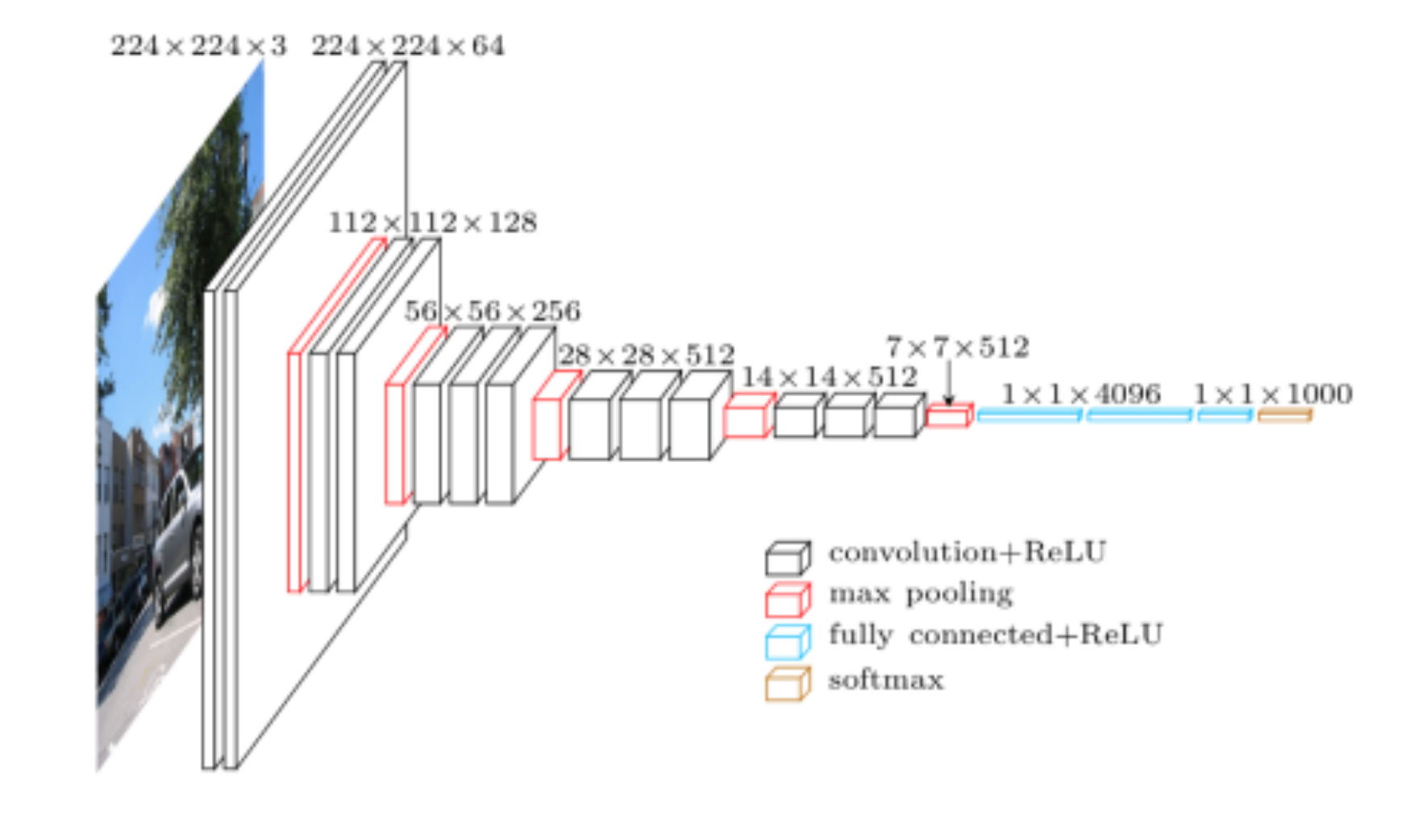
Convolutional Neural Network (VGG16)

Slide 8
Going Deeper with Convolutions
Recent evidence reveals that network depth is of crucial importance, and the leading results on the challenging ImageNet dataset all exploit “very deep” models, with a depth of sixteen to thirty.
VGGNet: K. Simonyan and A. Zisserman. Very deep convolutional networks for large-scale image recognition. In ICLR, 2015.
AlexNex: Imagenet classification with deep convolutional neural networks. In NIPS, 2012.
C.Szegedy,W.Liu,Y.Jia,P.Sermanet,S.Reed,D.Anguelov,D.Er- han, V. Vanhoucke, and A. Rabinovich. Going deeper with convolutions. In CVPR, 2015.

Slide 9
Outline
Convolutional Neural Network
Idea of Residual Learning
Image Classification(CIFAR-10)
Image Classification(ImageNet)

Slide 10
Motivation
Is learning better networks as easy as stacking more layers?
An obstacle to answering this question was the notorious problem of vanishing/exploding gradients , which hamper convergence from the beginning.
When deeper networks are able to start converging, a degradation problem has been exposed: with the network depth increasing, accuracy gets saturated (which might be unsurprising) and then degrades rapidly.
Unexpectedly, such degradation is not caused by overfitting, and adding more layers to a suitably deep model leads to higher training error.
Notes:
可看[1] [9]

Slide 11










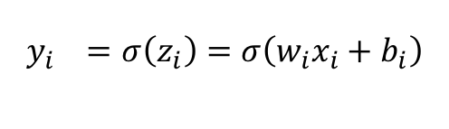



Vanishing/Exploding Gradients
x1
$$w_{1}$$
$$z_{1}$$
A
$$y_{1}$$
$$w_{2}$$
$$z_{2}$$
A
$$y_{2}$$
$$w_{3}$$
$$z_{3}$$
A
$$y_{3}$$
$$W^{+ }= w_{1} −\text{η}η\frac{∂\text{L} }{∂w_{1}}$$
L:Loss
$$\hat{Y}$$
$$z_{i}=w_{i}x_{i}+b_{i}$$
$$\frac{∂\text{L} }{∂w_{1}}=\frac{∂\text{L} }{∂y_{3}}\frac{∂y_{3} }{∂z_{3}}\frac{∂z_{3} }{∂y_{2}}\frac{∂y_{2} }{∂z_{2}}\frac{∂z_{2} }{∂y_{1}}\frac{∂y_{1} }{∂z_{1}}\frac{∂z_{1} }{∂w_{1}}$$
= $\frac{∂\text{L} }{∂y_{3}}σ^{′}\left(z_{3}\right)w_{3}σ^{′}\left(z_{2}\right)w_{2}σ^{′}\left(z_{1}\right)x_{1}$
$$y_{i }=σ\left(z_{i}\right)=σ\left(w_{i}x_{i}+b_{i}\right)$$

Slide 12
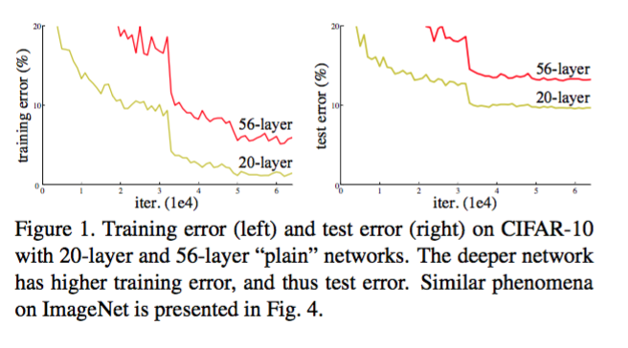
Degradation Problem

Slide 13
Degradation Problem(cont.)
The degradation (of training accuracy) indicates that not all systems are similarly easy to optimize.
There exists a solution by construction to the deeper model: the added layers are identity mapping, and the other layers are copied from the learned shallower model
The existence of this constructed solution indicates that a deeper model should produce no higher training error than its shallower counterpart. But experiments show that our current solvers on hand are unable to find solutions that are comparably good or better than the constructed solution (or unable to do so in feasible time).
Notes:
最優解存在，機器應該要學到最優解

Slide 14
Hypothesis
The degradation problem suggests that the solvers might have difficulties in approximating identity mappings by multiple nonlinear layers.
With the residual learning reformulation, if identity mappings are optimal, the solvers may simply drive the weights of the multiple nonlinear layers toward zero to approach identity mappings.
If the optimal function is closer to an identity mapping than to a zero mapping, it should be easier for the solver to find the perturbations with reference to an identity mapping, than to learn the function as a new one

Slide 15
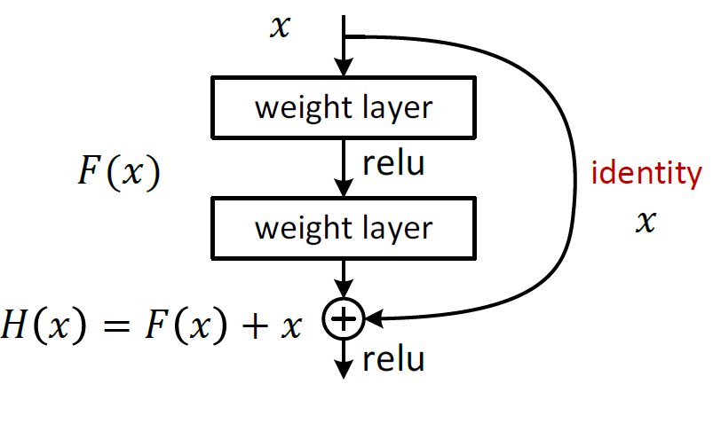
Solution for Degradation Problem
Instead of hoping each few stacked layers directly fit a desired underlying mapping, we explicitly let these layers fit a residual mapping.
Denoting the desired underlying mapping as H(x), we let the stacked nonlinear layers fit another mapping of F (x) := H(x) − x. The original mapping is recast into F(x)+x.
We hypothesize that it is easier to optimize the residual mapping than to optimize the original, unreferenced mapping.
To the extreme, if an identity mapping were optimal, it would be easier to push the residual to zero than to fit an identity mapping by a stack of nonlinear layers.

Slide 16
Residual Building Block
In our case, the shortcut connections simply perform identity mapping, and their outputs are added to the outputs of the stacked layers.
Dentity shortcut connections add neither extra parameter nor computational complexity.

Slide 17
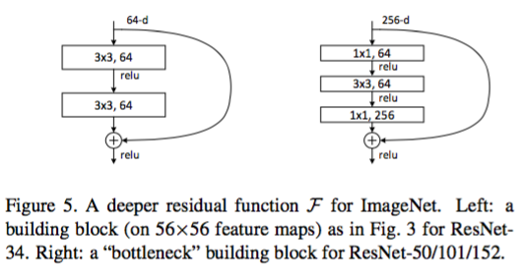
Deeper Bottleneck Architectures.
Because of concerns on the training time that we can afford, we modify the building block as a bottleneck design.
function F , we use a stack of 3 layers instead of 2. The three layers are 1×1, 3×3, and 1×1 convolutions, where the 1×1 layers are responsible for reducing and then increasing (restoring) dimensions,
For each residual function F , we use a stack of 3 layers instead of 2
increasing (restoring) dimensions

Slide 18
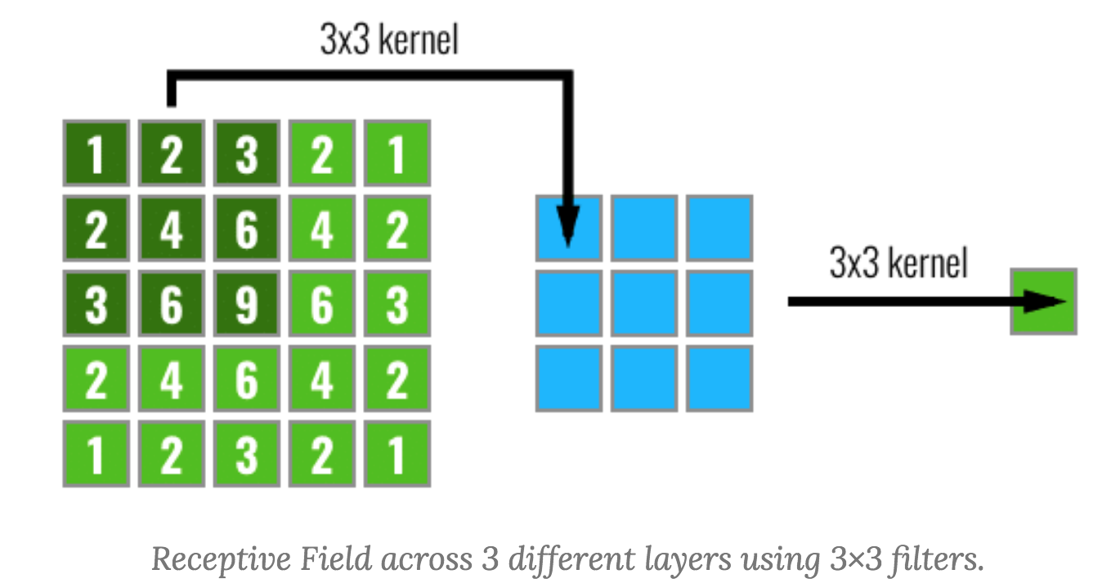
Why 3x3 conv?
It is easy to see that a stack of two 3 × 3 conv. layers (without spatial pooling in between) has an effective receptive field of 5 × 5
First, we incorporate three non-linear rectification layers instead of a single one, which makes the decision function more discriminative.
Second, we decrease the number of parameters: assuming that both the input and the output of a three-layer 3 × 3 convolution stack has C channels
This can be seen as imposing a regularisation on the 7 × 7 conv. filters, forcing them to have a decomposition through the 3 × 3 filters (with non-linearity injected in between).
source: http://blog.christianperone.com/2017/11/the-effective-receptive-field-on-cnns/
Notes:
3*3 有比較少的參數量，而且可以經過比較多次af。所以會損失比較多資訊，train data比較少

Slide 19
Outline
Convolutional Neural Network
Idea of Residual Learning
Image Classification(CIFAR-10)
Image Classification(ImageNet)

Slide 20
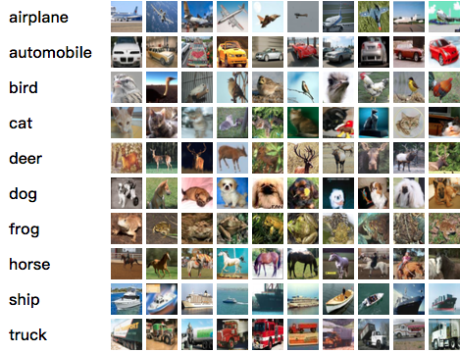
CIFAR-10
The CIFAR-10 dataset consists of 60000 32x32 colour images in 10 classes, with 6000 images per class. There are 50000 training images and 10000 test images.

Slide 21
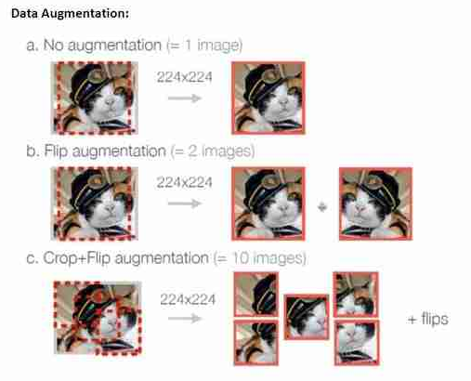
Data Augmentation
source: https://mc.ai/data-augmentation-using-fastai/
Notes:
https://mc.ai/data-augmentation-using-fastai/
選轉裁切成更多圖片

Slide 22
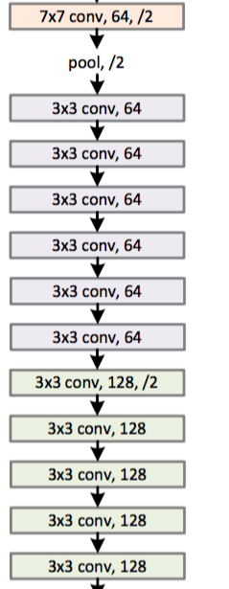
Plain Network
For the same output feature map size, the layers have the
same number of filters.
If the feature map size is halved, the number of filters is
doubled.
We perform downsampling directly by convolutional layers that
have a stride of 2.

Slide 23
Downsampling by Stride =2
4x4 input
1 | 1 | 2 | 4
1 | 1 | 2 | 8
3 | 2 | 1 | 0
1 | 2 | 3 | 4
filter
output
1 | 1
1 | 1
1 | 4
2 | 2

Slide 24
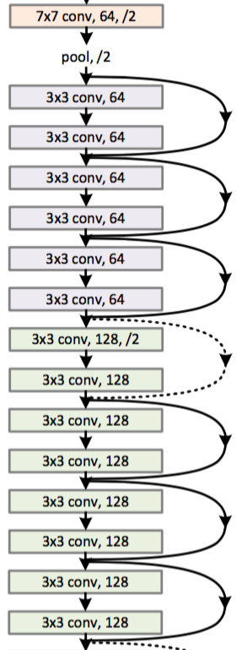
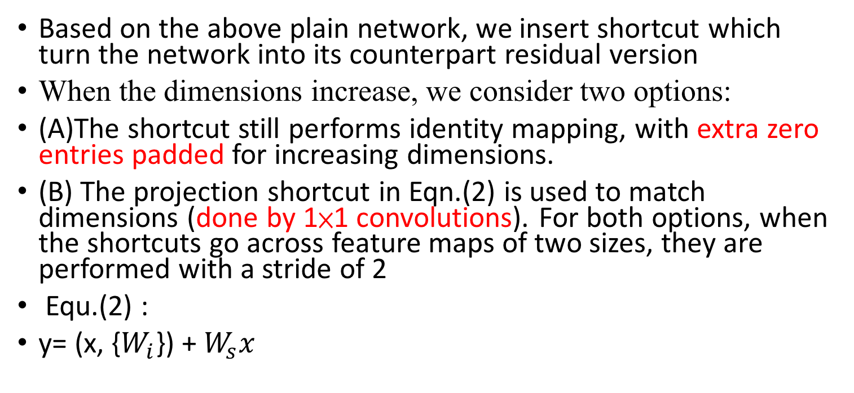
Residual Network
Based on the above plain network, we insert shortcut which turn the network into its counterpart residual version
When the dimensions increase, we consider two options:
(A)The shortcut still performs identity mapping, with extra zero entries padded for increasing dimensions.
(B) The projection shortcut in Eqn.(2) is used to match dimensions (done by 1×1 convolutions). For both options, when the shortcuts go across feature maps of two sizes, they are performed with a stride of 2
Equ.(2) :
y= (x, {$W_{i}$}) + $W_{s}x$
Notes:
downsampling outpu做zero padding
相加，1x1 downsampling

Slide 25
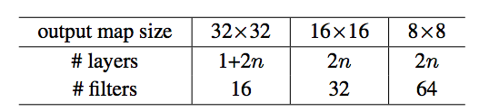
Residual Architectures for CIFAR-10
The first layer is 3×3 convolutions.
Then we use a stack of 6n layers with 3×3 convolutions on the feature maps of sizes {32, 16, 8} respectively, with 2n layers for each feature map size.
n : numbers of Residual Building Block in one output map size
The numbers of filters are {16, 32, 64} respectively.
The subsampling is performed by convolutions with a stride of 2.
The network ends with a global average pooling, a 10-way fully-connected layer, and softmax.
Same padding

Slide 26

input
res_block
res_block
res_block
res_block
res_block
res_block
num_res_block
=3
res_block
res_block
res_block
Notes:
紅線降維度

Slide 27
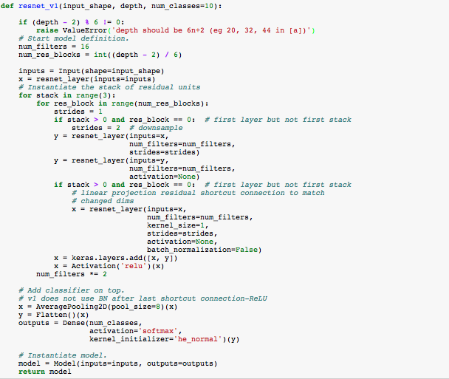
Keras Example
input
res_block
res_block
res_block
res_block
res_block
res_block
res_block
res_block
res_block

Slide 28
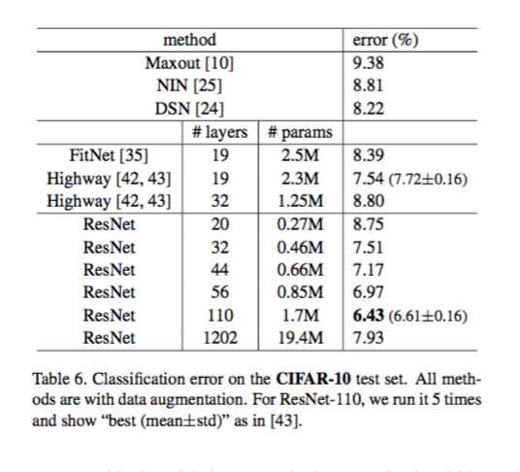
Evaluation
We compare n = {3, 5, 7, 9}, leading to 20, 32, 44, and 56-layer networks.

Slide 29
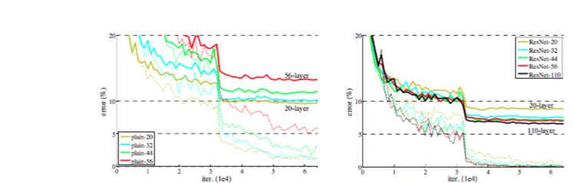
Training on CIFAR10
Dashed lines denote training error, and bold lines denote testing error
The deep plain nets suffer from increased depth, and exhibit higher training error when going deeper
Our ResNets manage to overcome the optimization difficulty and demonstrate accuracy gains when the depth increases.

Slide 30
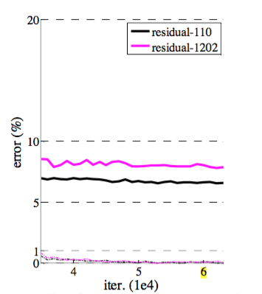
Exploring Over 1000 layers
We explore an aggressively deep model of over 1000 layers. We set n = 200 that leads to a 1202-layer network,
Our method shows no optimization difficulty, and this 103-layer network is able to achieve training error <0.1%.
Its test error is still fairly good (7.93%)
The testing result of this 1202-layer network is worse than that of our 110-layer network.
We argue that this is because of overfitting. The 1202-layer network may be unnecessarily large (19.4M) for this small dataset.
Notes:
雖然training error 一樣但是testing 110layer 好於1202 layers

Slide 31
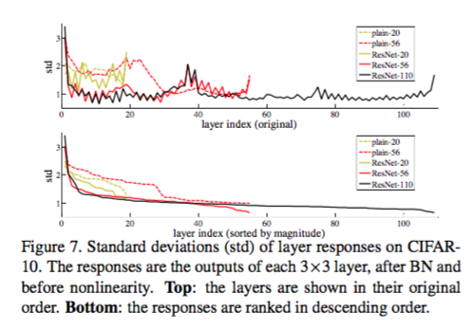
Analysis of Layer Responses.
the residual functions might be generally closer to zero than the non-residual functions.

Slide 32
Outline
Convolutional Neural Network
Idea of Residual Learning
Image Classification(CIFAR-10)
Image Classification(ImageNet)

Slide 33
Imagenet Classification
We evaluate our method on the ImageNet 2012 classification dataset that consists of 1000 classes
The models are trained on the 1.28 million training images, and evalu- ated on the 50k validation images.
We also obtain a final result on the 100k test images, reported by the test server. We evaluate both top-1 and top-5 error rates.

Slide 34
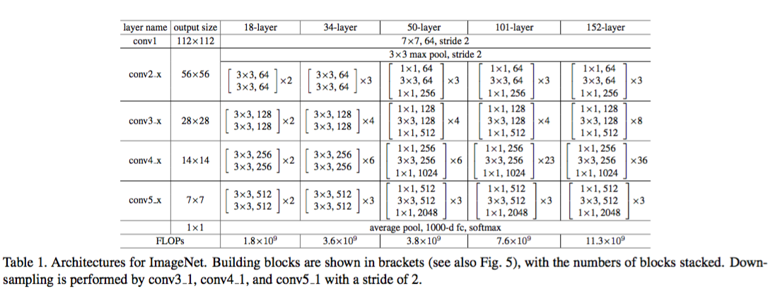
Architecture for Imagenet

Slide 35
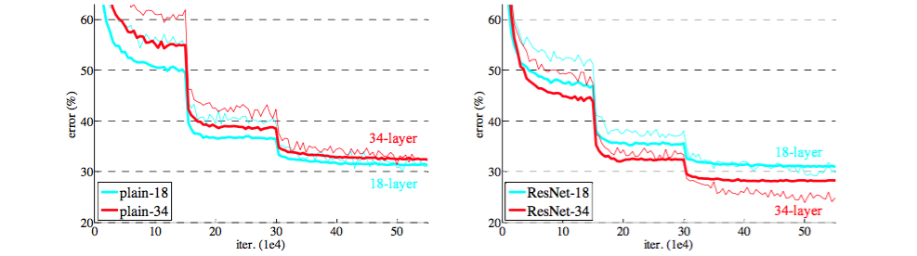
Training on ImageNet
thin curves denote training error, and bold curve denote validation error of center crops
left: plain networks of 18 and 34 layers Right: Resnet of 18 and 34 layers

Slide 36
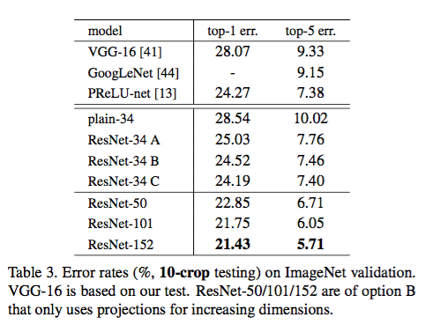
Evaluation

Slide 37
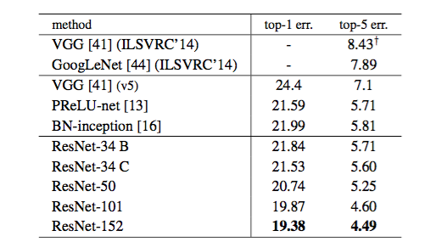
Evaluation(Cont.)

Slide 38
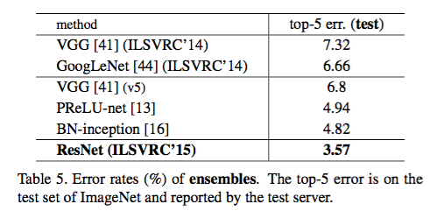
Evaluation(Cont.)

